Slide 1
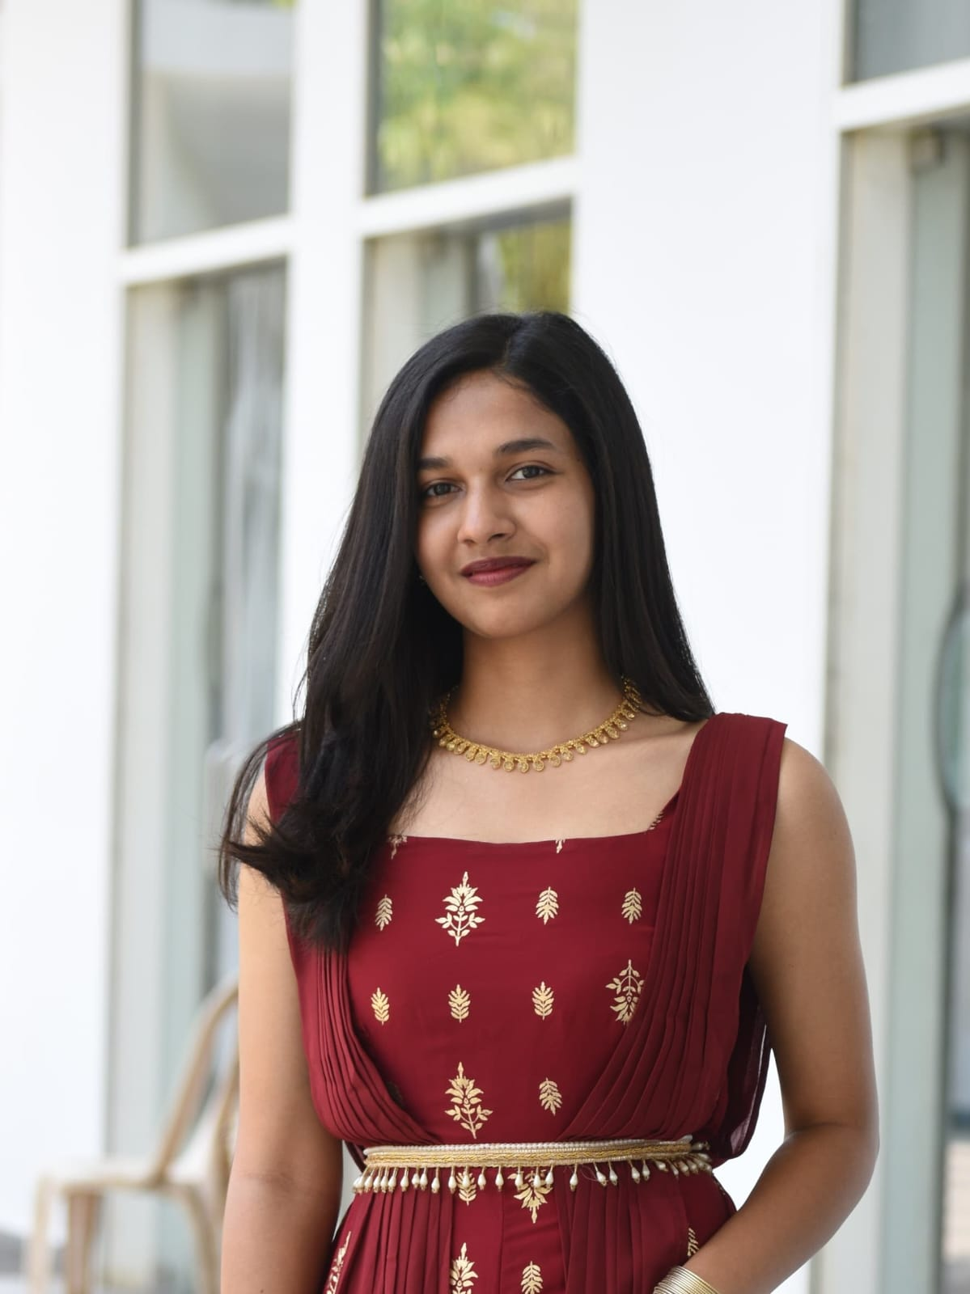

Student Details
Name – Nafisa rehmani
SkillsBUILD EMAIL ID – nafisa.08rehmani@gmail.com
COLLEGE NAME – SRM UNIVERSITY AP
COLLEGE STATE – ANDHRA PRADESH
INTERNSHIP DOMAIN – FRONT-END DEVELOPMENT(fed)
Internship start and end date – 3rd June to 25th July [03.06-2024 – 25.07.2024]

Slide 2
PROJECT TITLE/Problem Statement
PROJECT TITLE: Personal Portfolio Website
PROBLEM STATEMENT:
To create a visually appealing, user-friendly, and responsive online platform that effectively showcases a developer's skills, projects, and experiences to potential employers or clients using HTML,CSS and JavaScript (i.e., Frontend technologies).
Problem: Crafting a personal portfolio can be challenging, particularly for individuals without experience or who lack basic understanding in web design or programming, making it difficult to accurately represent their accomplishments and personal brand.

Slide 3
AGENDA
Introduction: Briefly introduce yourself and the purpose of the presentation.
Problem Statement: Clearly state the problem or need that your project aims to address. Explain why this problem is important to solve.
Project Overview: Provide a high-level overview of your project. Discuss the goals, scope, and objectives of the project.
End Users: Identify and describe the target audience for your project. Explain the needs and characteristics of the end users.
Solution and Value Proposition: Present your solution to the problem identified earlier. Explain the unique value your solution provides to the end users.
Customization: Highlight any unique customizations or features you added to the project.
Technical Details: Provide an overview of the technologies and tools used in the project.
Future Work: Discuss potential future enhancements or improvements for your project.
Conclusion: Summarize the key points covered in your presentation.

Slide 4
PROJECT OVERVIEW
Purpose: To create a personal online portfolio website that highlights my skills, projects, and professional journey.
Scope: A responsive and interactive website with sections such as About Me, Projects, Skills, and Contact.
Objectives: To improve online presence, facilitate job applications, and demonstrate technical skills.
Ensure Accessibility and Usability: Designed with (using frontend) HTML, CSS, and JavaScript, the portfolio offers a user-friendly experience, emphasizing accessibility and simplicity.
.

Slide 5
WHO ARE THE END USERS of this project?
Engineering students seeking to showcase their work.
Engineering students need a platform to display their work professionally.
Potential employers and recruiters looking for candidates.
Employers need an easy way to evaluate the skills and projects of potential candidates.
Academic institutions evaluating student projects.
Institutions need to assess the practical applications of student knowledge.
General audience.
To learn more about the individual’s work and expertise.

Slide 6
Benefits:
Provides a professional online presence.
Facilitates easier evaluation by employers.
Enhances visibility and networking opportunities.

Slide 7
YOUR SOLUTION AND ITS VALUE PROPOSITION
Solution: Developed a responsive portfolio website using HTML, CSS, and JavaScript.
Value Proposition:
Professional and organized display of skills and projects.
Easy navigation and user-friendly interface.
Enhanced visibility and accessibility for potential employers.

Slide 8
How did you customize the project and make it your own
Customization:
Added custom design elements and animations.
Integrated interactive features such as project carousels and contact forms.
Personalized content with unique sections like ‘about me’ section.
Unique Aspects:
Custom animations using CSS and JavaScript.
Responsive design ensuring compatibility across devices.
Integration with social media links for broader connectivity.

Slide 9
MODELLING
Layout: Clean and intuitive layout with clear navigation.
Typography: Readable fonts with a mix of headings and body text to enhance readability.
Imagery: High-quality images and icons to make the website visually appealing.
Interactive Elements: Smooth animations and hover effects to enhance user experience.
Social Media Integration: Links to social media profiles for broader reach and networking.

Slide 10
Technical details
Frontend Technologies:
HTML: Structured the content of the website.
CSS: Styled the website, making it visually appealing and responsive.
JavaScript: Added interactivity and dynamic content.
Tools Used:
Visual Studio Code for coding.
Git and GitHub for version control.
Browser Developer Tools for testing and debugging.
Implementation:
Designed the layout using HTML and CSS.
Added interactivity with JavaScript.
Tested across different devices to ensure responsiveness.

Slide 11
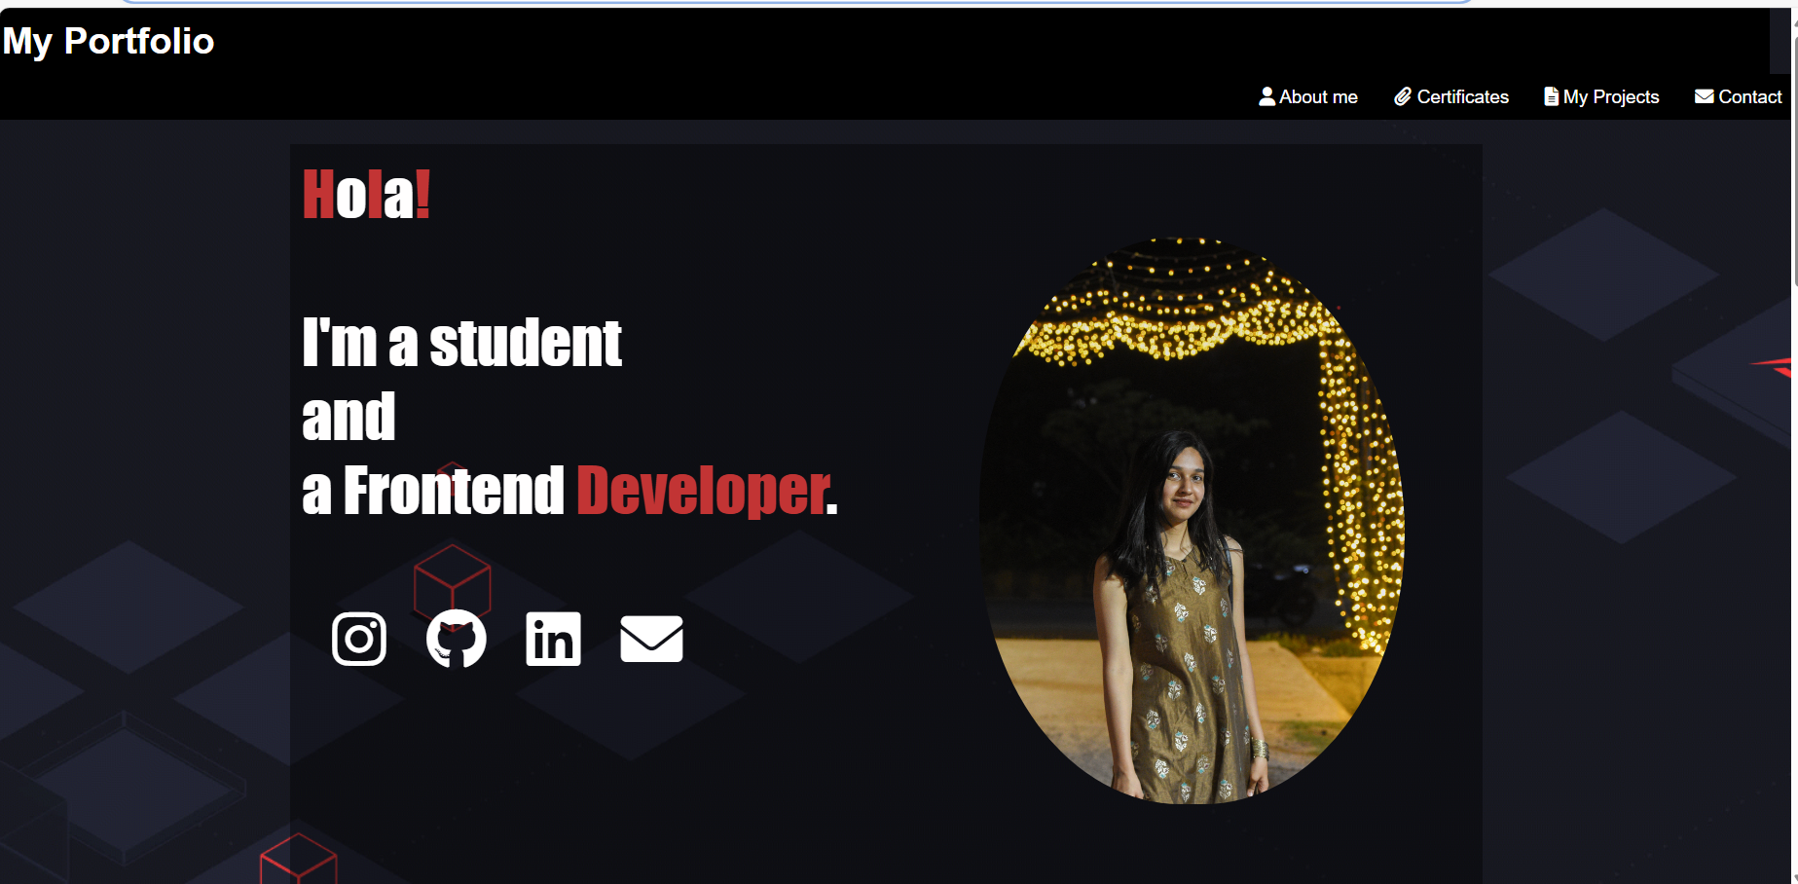
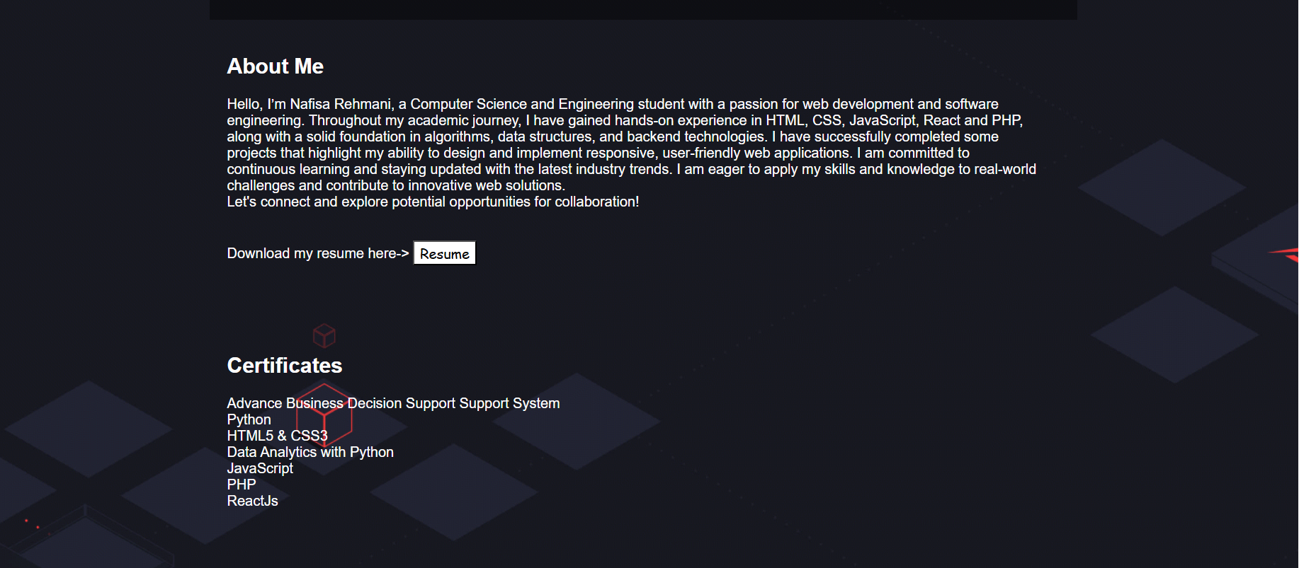
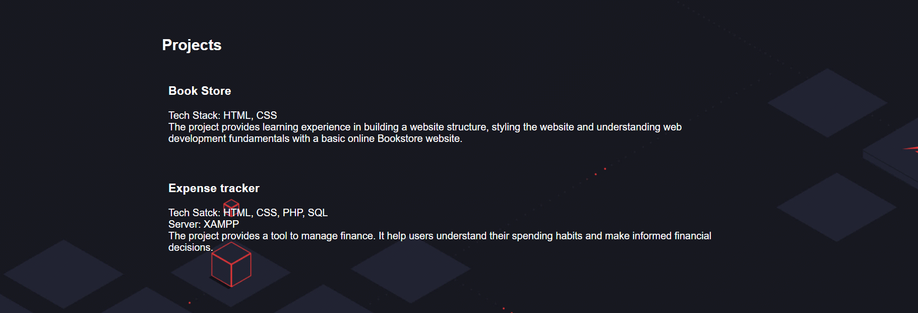
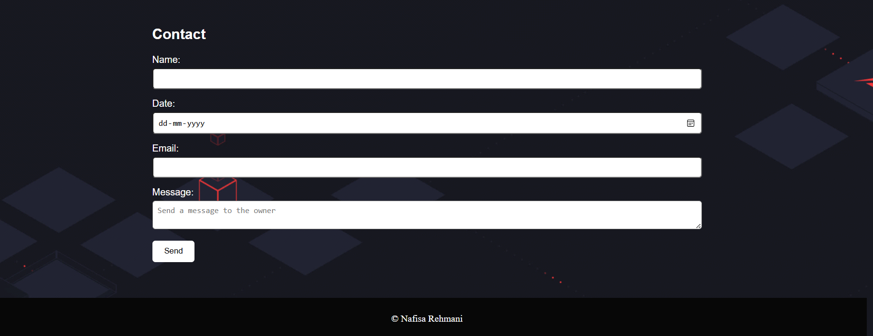
Results

Slide 12
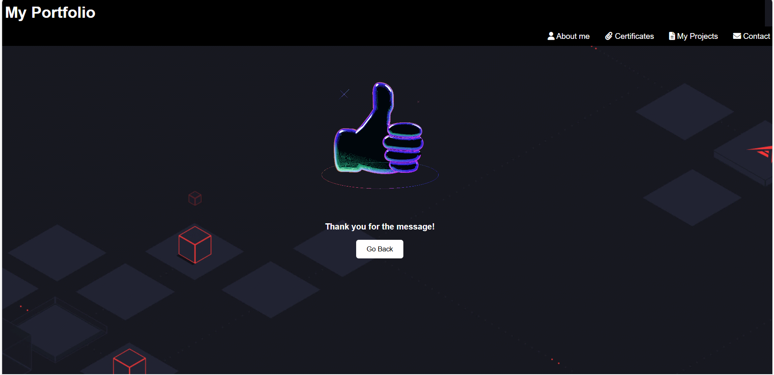
Results

Slide 13
links
Project Links:
GitHub Repository: FED-Portfolio
Live Demo: Portfolio Website

Slide 14
References:
Chatgpt
CodingNepal
Codehalweb
YouTube
W3Schools
IBM Skills Builder-FED course plan

Slide 15
Future work
Backend Integration: Develop a backend for form submissions and data management.
Blog Section: Add a fully functional blog with comments and likes.
Multimedia Enhancements: Include videos and interactive project galleries.
Enhanced Interactivity: Add more interactive elements with libraries like Three.js.
Security Enhancements: Implement HTTPS, encryption, and security audits.
Feedback: Add a section for feedback.

Slide 16
Conclusion
The development of a personal portfolio website using HTML, CSS, and JavaScript serves as an essential project to showcase academic achievements, technical skills, and project work in a professional manner. This project not only enhances the student's online presence but also significantly increases their marketability to potential employers, academic institutions, and collaborators.

Slide 17
Thank you!

